Slide 1


Trace & Color
Transportation
Bulldozer

Slide 2


Trace & Color
Crane
Transportation

Slide 3


Trace & Color
Transportation
Rocket

Slide 4
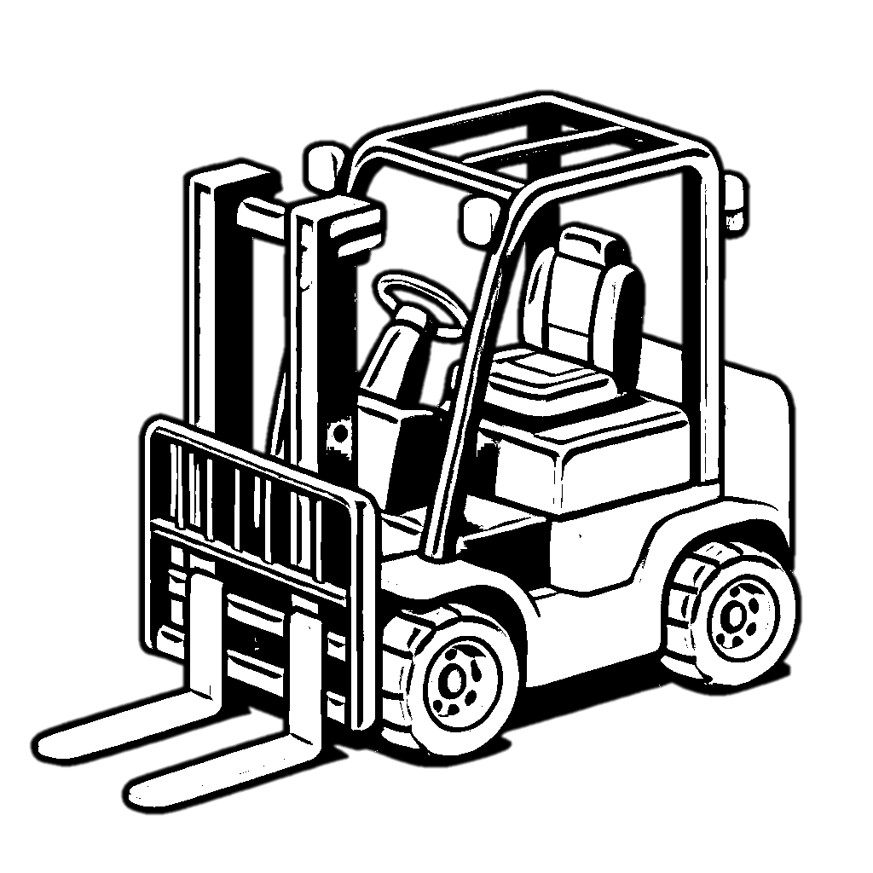

Trace & Color
Transportation
Forklift

Slide 5


Trace & Color
Transportation
Excavator

Slide 6


Trace & Color
Tractor
Transportation

Slide 7


Trace & Color
Transportation
Ambulance

Slide 8


Trace & Color
Ship
Transportation

Slide 9


Trace & Color
Transportation
Boat

Slide 10


Trace & Color
Transportation
Motorcycle

Slide 11


Trace & Color
Zeppelin
Transportation

Slide 12


Trace & Color
Carriage
Transportation

Slide 13


Trace & Color
Sleigh
Transportation

Slide 14


Trace & Color
Cable car
Transportation

Slide 15


Trace & Color
Transportation
Jet ski

Slide 16


Trace & Color
Pickup
Transportation

